Slide 1
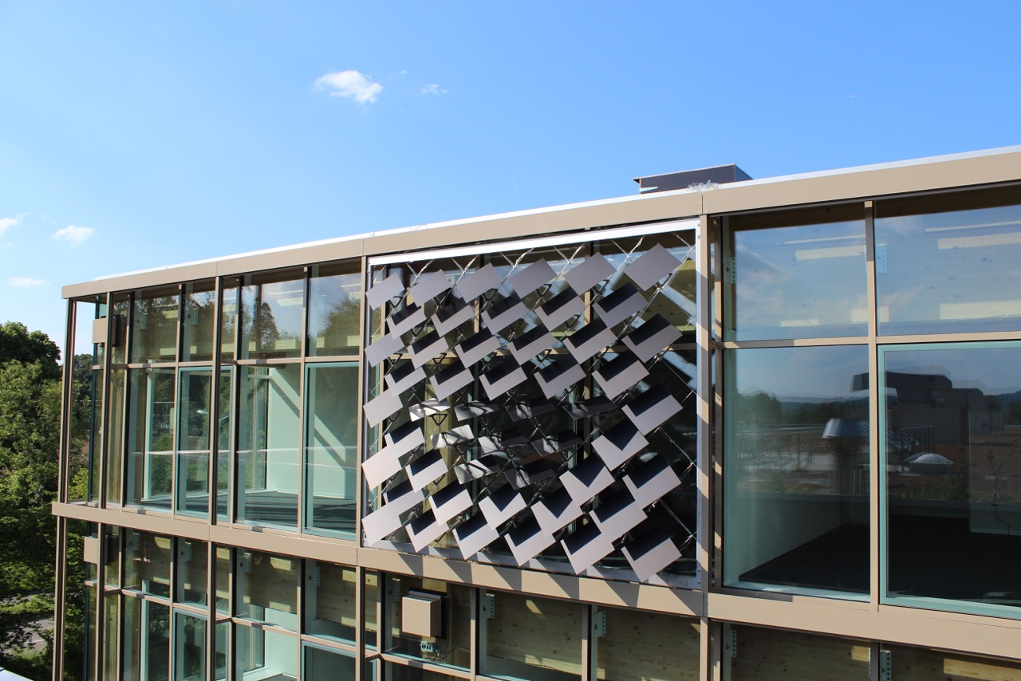
Numerical Energy Analysis of PV Modules as Adaptive Building Shading Systems
Master Thesis
Jeremias Schmidli
Supervisor:
Prageeth Jayathissa

Slide 2
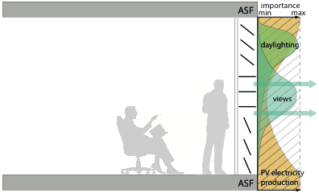
The Adaptive Solar Façade (ASF)
Individually Actuated Panels
Combines Dynamic Shading with PV-Electricity Production
Needs to Be Optimized for Cooling, Heating, Lighting and PV-Electricity Production

Slide 3
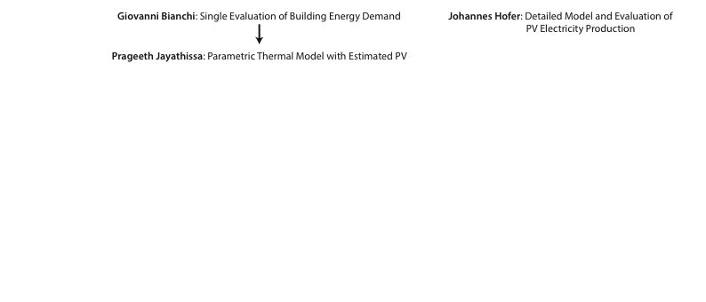

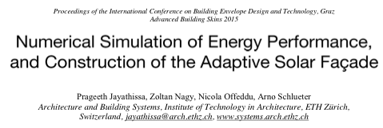
Previous Work

Slide 4
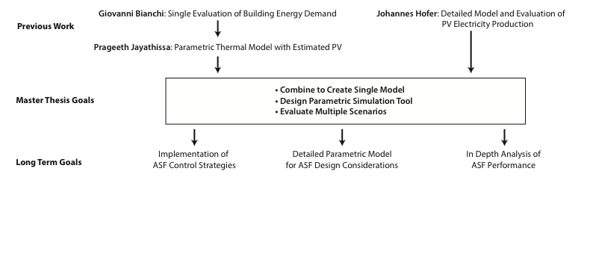
ASF Simulation Goals
Notes:
Evaluate multiple scenarios of the asf,
for example building oriention, location or building system sensitivity
Implementation of ASF control strategies

Slide 5
Overview
Introduction
Problem Description
Methodology
Results and Discussion
Conclusions and Outlook

Slide 6
Problem Description
Optimization Problem
Minimize: C + H + L – PV
C = Cooling Electricity Demand
H = Heating Electricity Demand
L = Lighting Electricity Demand
PV = Photovoltaic Electricity Supply

Slide 7
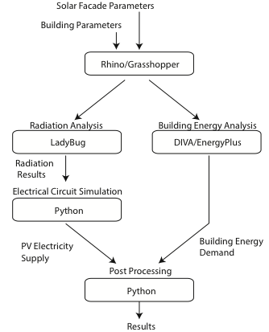
Methodology
Combination Of Different Tools To Achieve Optimal Results
Minimize: C + H + L – PV
Notes:
Top to bottom

Slide 8
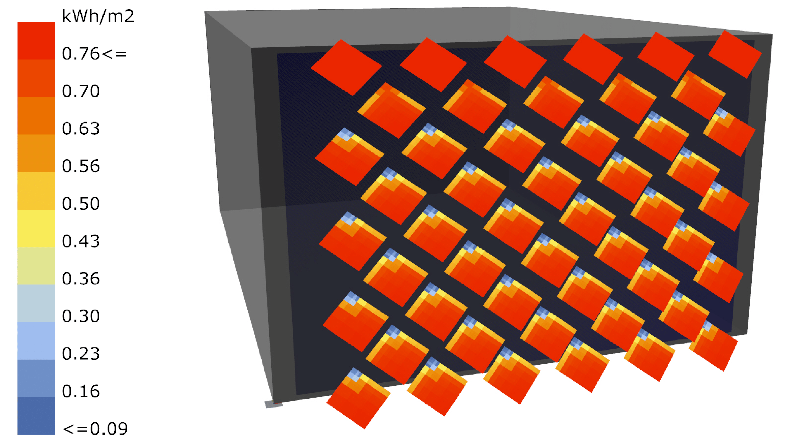
Radiation and PV analysis
(Collaboration with Johannes)
Radiation Analysis with Ladybug
Includes Self-Shading
Detailed PV Simulation with Python
Electrical Model includes Temperature and Radiation Dependency
Insolation from 12:00-13:00 on August 11

Slide 9
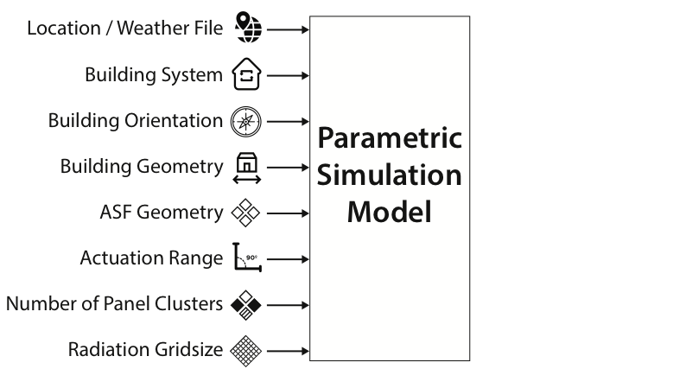
Parametric Model
Notes:
Developed tool that can be used by everyone
Downloadable at Github
Clusters of independently actuated panels
Detailed description of output

Slide 10

Parametric Model
Notes:
Developed tool that can be used by everyone
Downloadable at Github
Clusters of independently actuated panels
Detailed description of output

Slide 11
Base Case
Single Zone Office
Simulation for One Year
Weather File for Kloten-Zurich
Heating COP: 4
Cooling COP: 3
Lighting Load: 11.74 W/m²
Infiltration Rate: 1/h
50 Panels in a Single Cluster
Notes:
Dont read the parameters

Slide 12
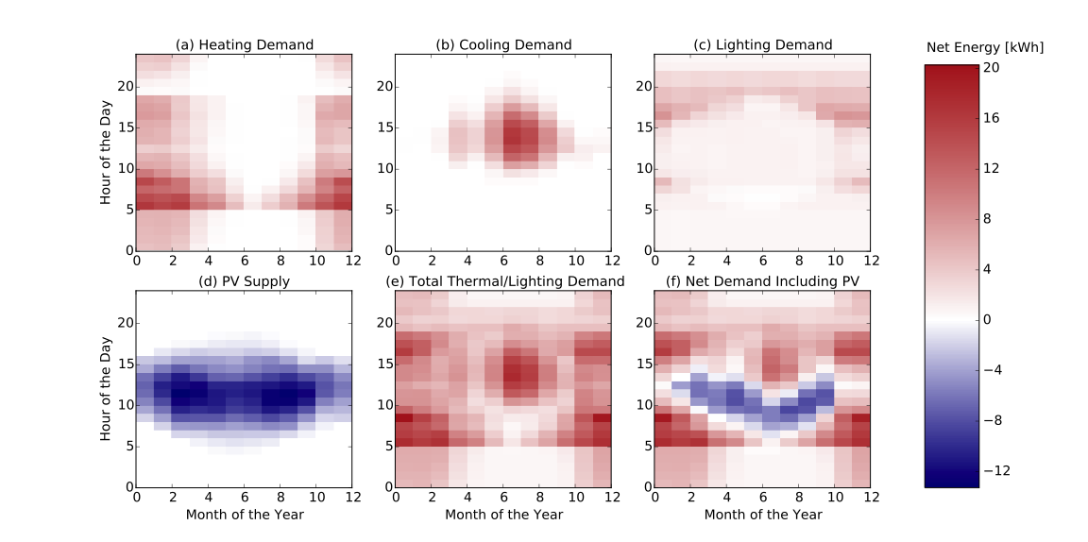
Net Energy Demand at Optimum Panel Angles

Slide 13
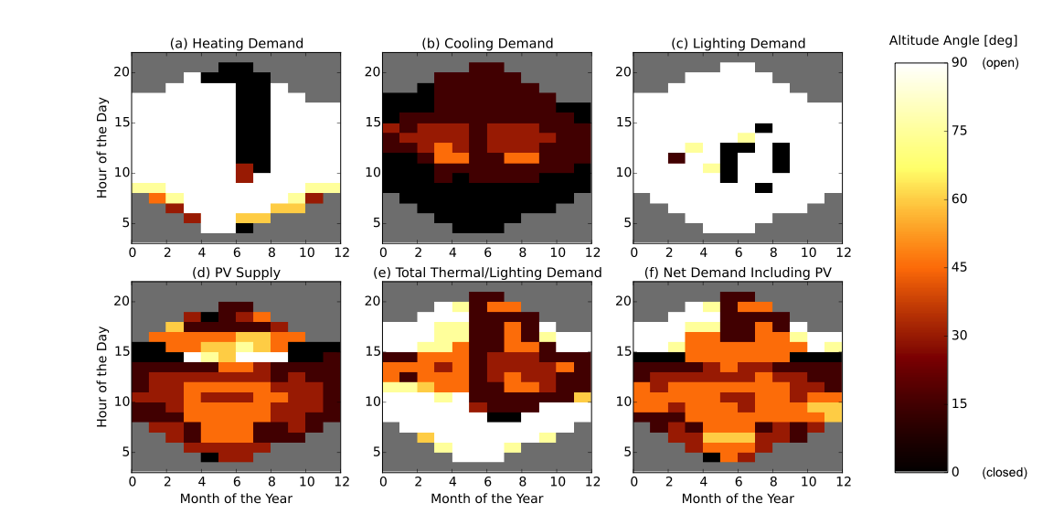
Optimum Altitude Angles of Panels
Notes:
We split up the results into altitude and azimuth angles for ease of visualization

Slide 14
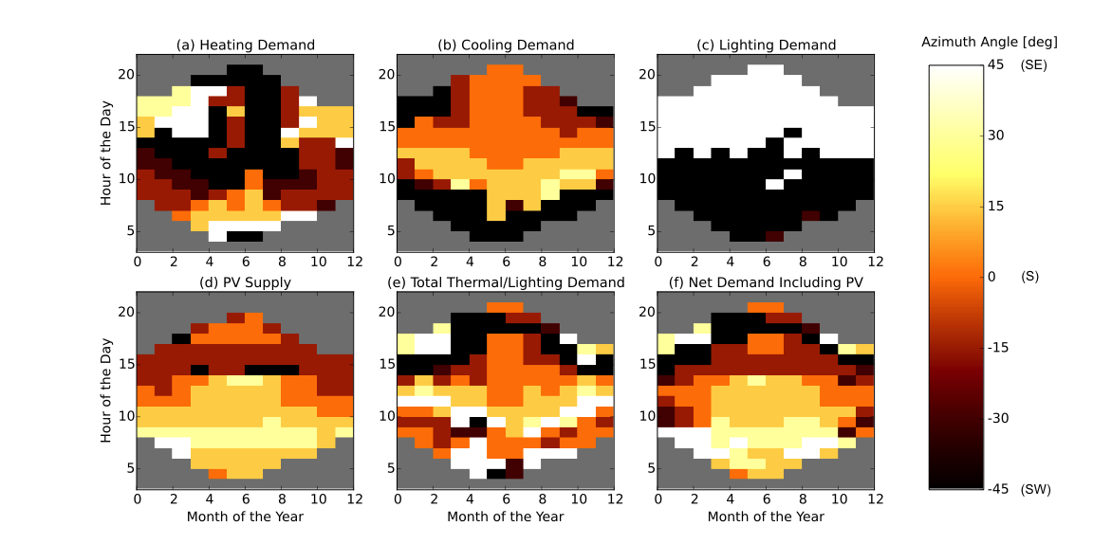
Optimum Azimuth Angles of Panels

Slide 15
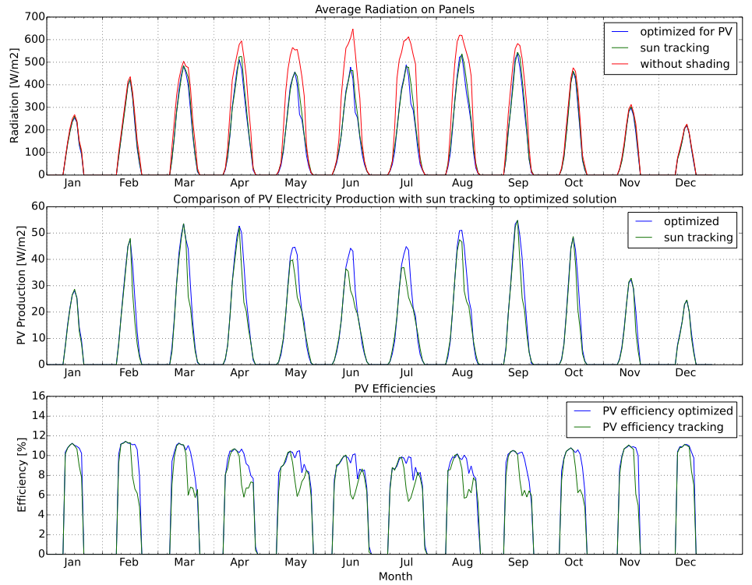
PV: Sun-Tracking vs. PV Optimization
- Similar Radiation
- Large Loss due to Shading

Slide 16
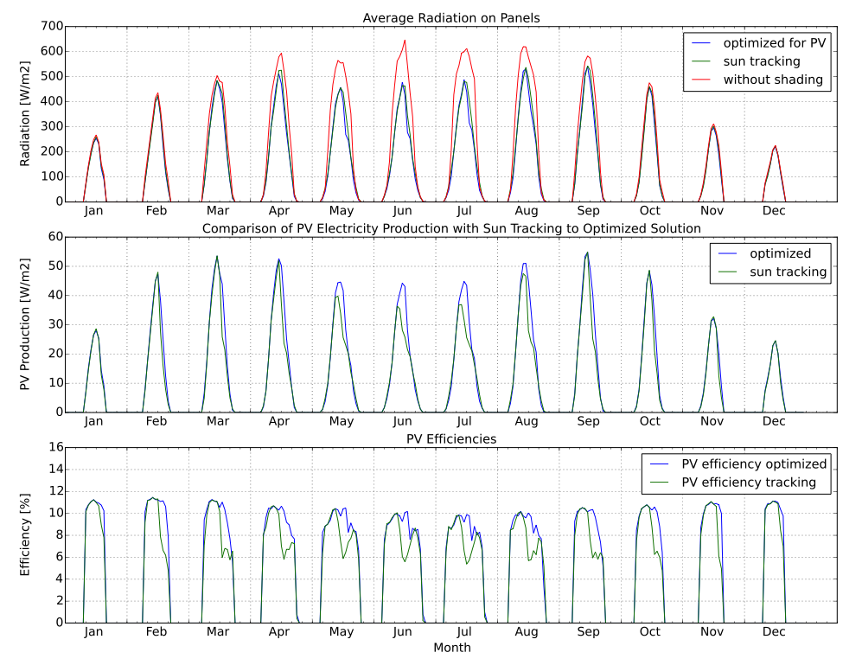
PV: Sun-Tracking vs. PV Optimization
- Similar Radiation
- Large Loss due to Shading
- Higher Electricity Production for Optimized Solution
- Higher Efficiency with Optimized Solution
Notes:
Give a small conclusion

Slide 17
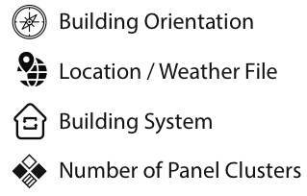
Parameter Variations
Performance Evaluation in Dependence of:

Slide 18
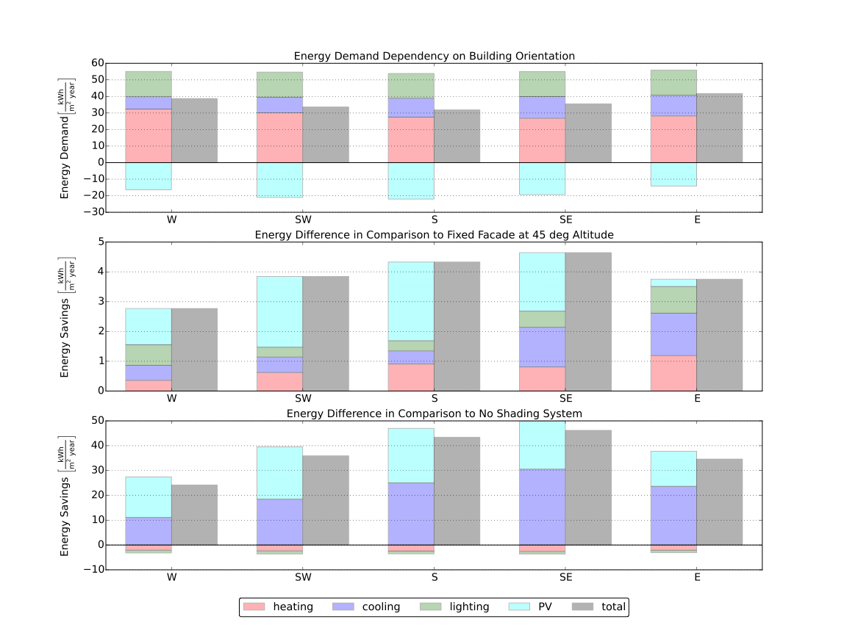

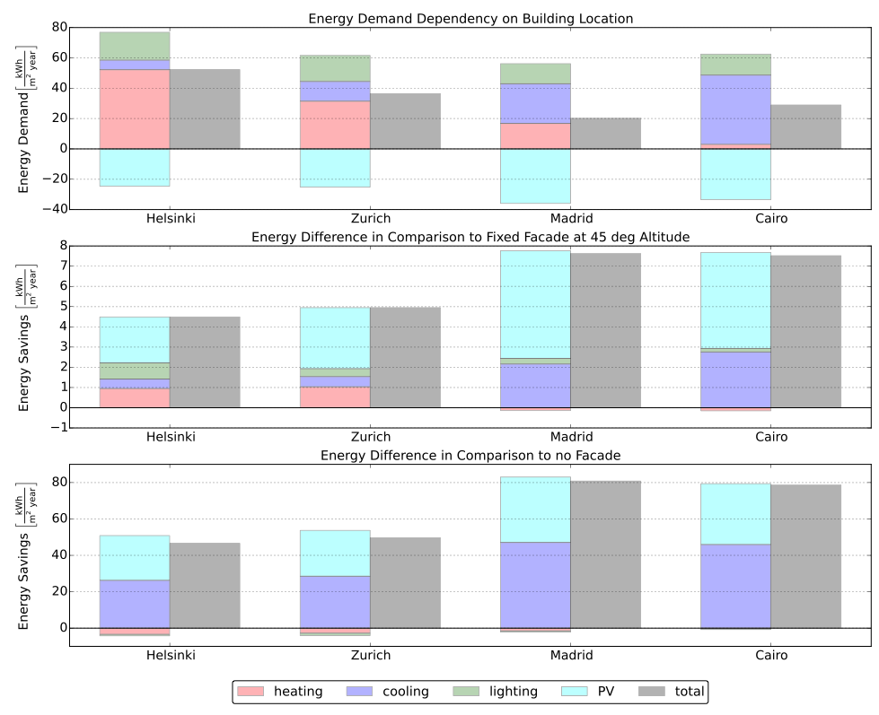
Building Orientation Performance
South facing office performs best

Slide 19

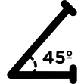
Building Orientation Performance
South facing office performs best
Highest benefit from ASF for south-east facing facade due to cooling
VS.
VS.

Slide 20
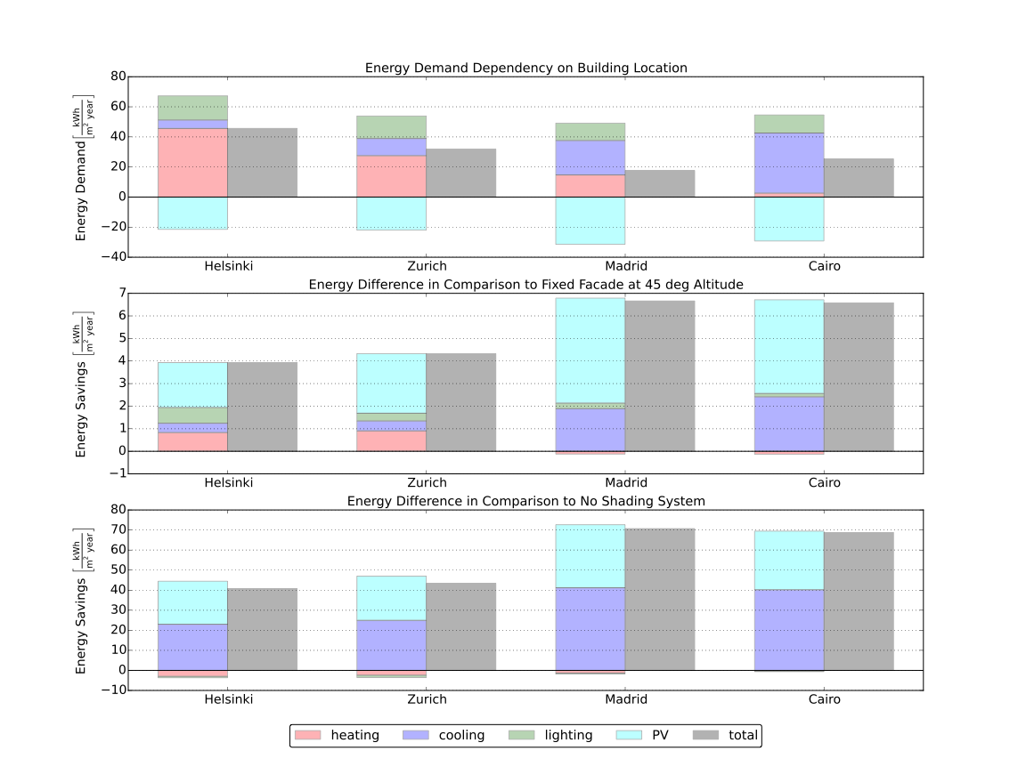
Building Location Performance
Office in Madrid performs best

Slide 21
Building Location Performance
Office in Madrid performs best
VS.
Highest benefit from ASF for warm
regions
VS.

Slide 22

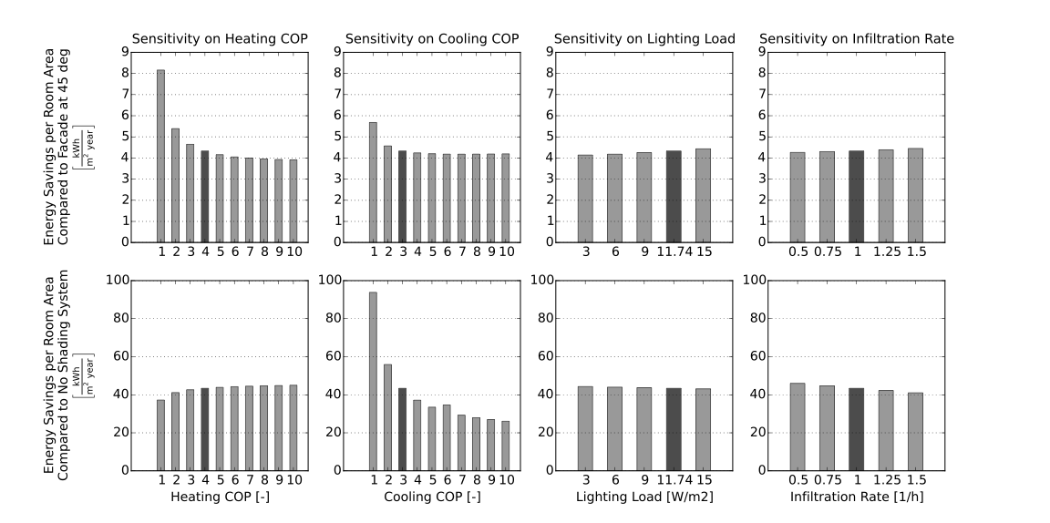



Building System Sensitivity
VS.
VS.
High sensitivity on heating COP and cooling COP
Lower sensitivity on lighting load and infiltration rate
Notes:
Give Conclusion

Slide 23
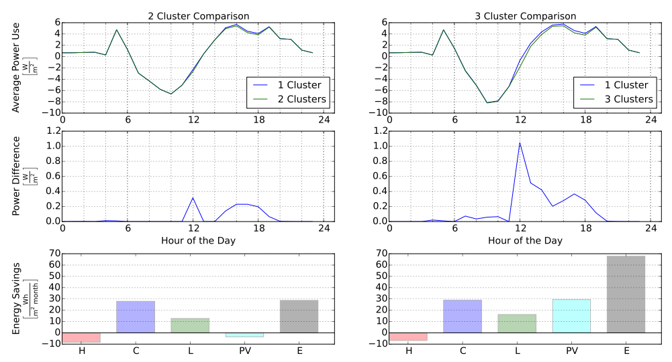


Cluster Analysis
2 Clusters
3 Clusters
June
1%
2.3%
Average of
Mar, Jun,
Sep, Dec

Slide 24
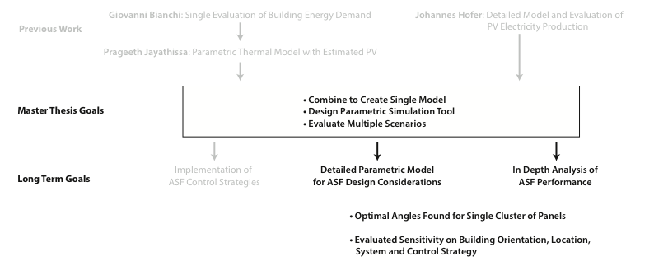
Conclusions

Slide 25
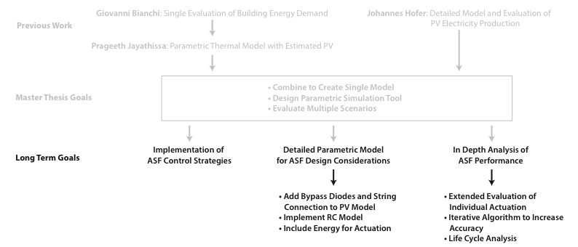
Outlook
Notes:
capitalization

Slide 26
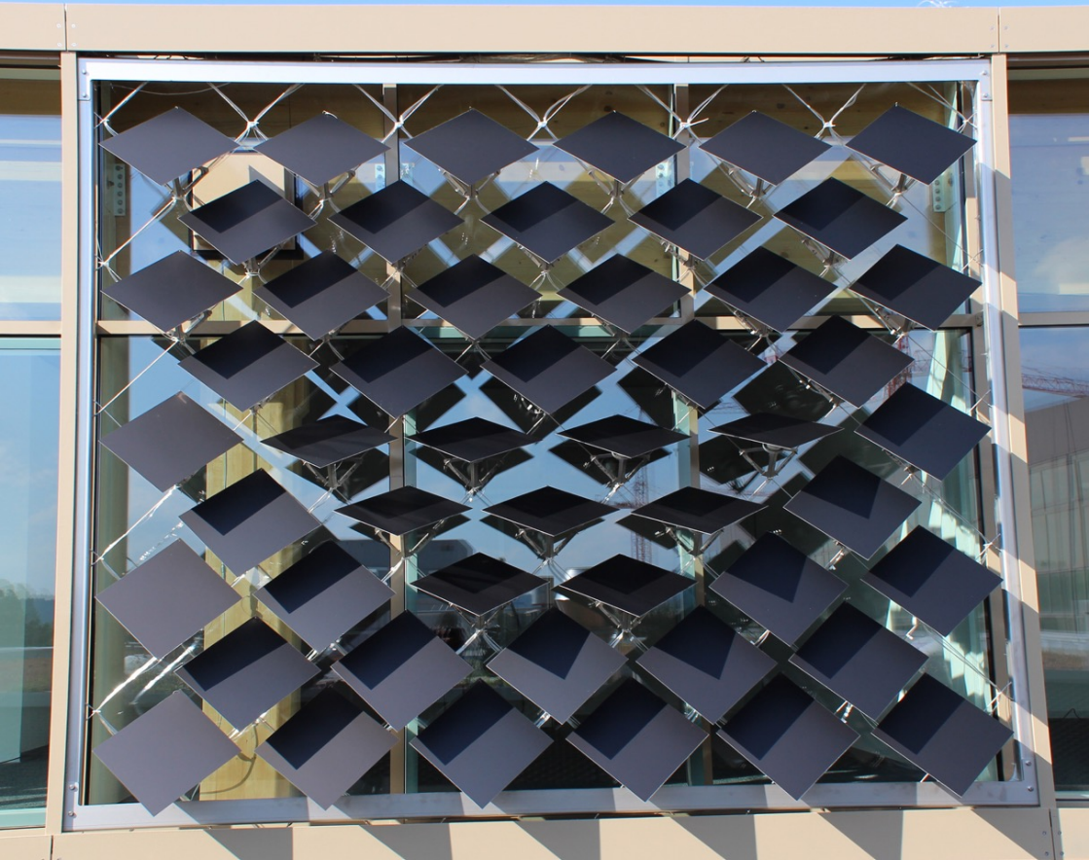
Questions?
https://github.com/architecture-building-systems/ASF_Simulation

Slide 27
Optimum Altitude Angles of Panels

Slide 28
Optimum Azimuth Angles of Panels

Slide 29
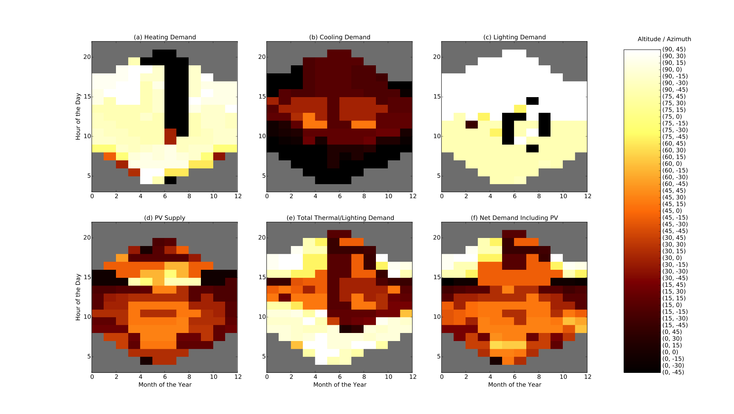
Optimum Angle Combinations of Panels

Slide 30
Net Energy Demand at Optimum Panel Angles

Slide 31
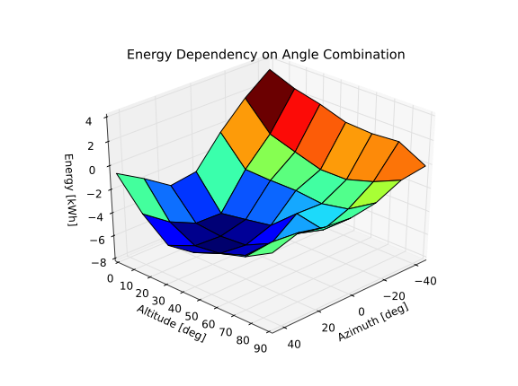
Discrete Optimization
7 Altitude Angles
7 Azimuth Angles
49 total Combinations
Minimum Total Energy

Slide 32
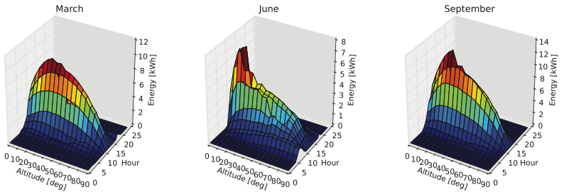
Influence of Actuation
Strongest Influence at Noon
Optimizing for Cooling and PV (closed positions)

Slide 33
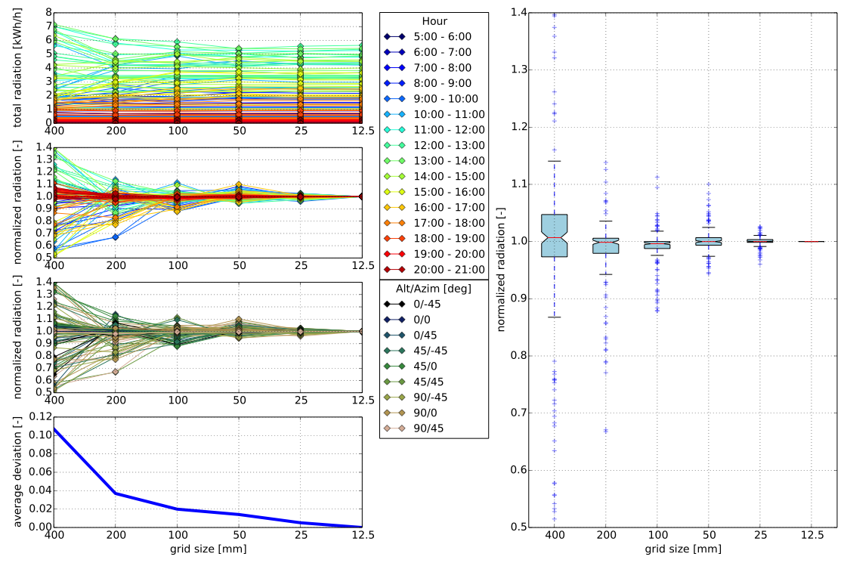
Grid Convergence Study

Slide 34
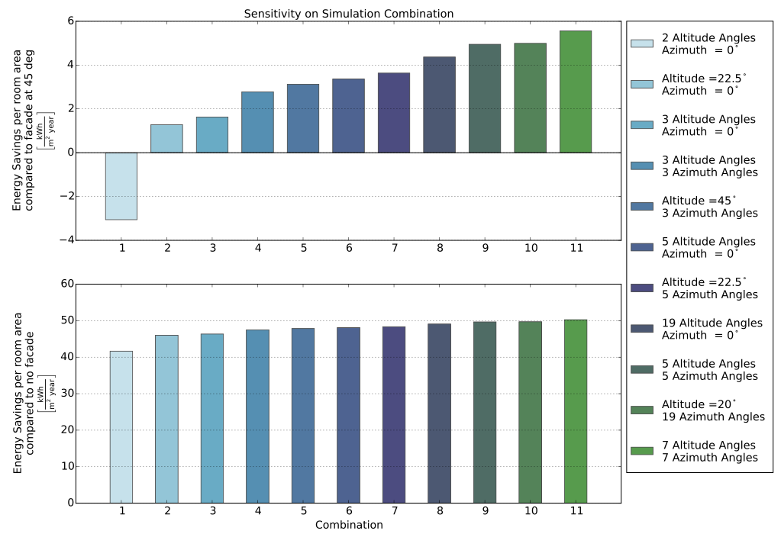
Sensitivity on Simulation Combination

Slide 35
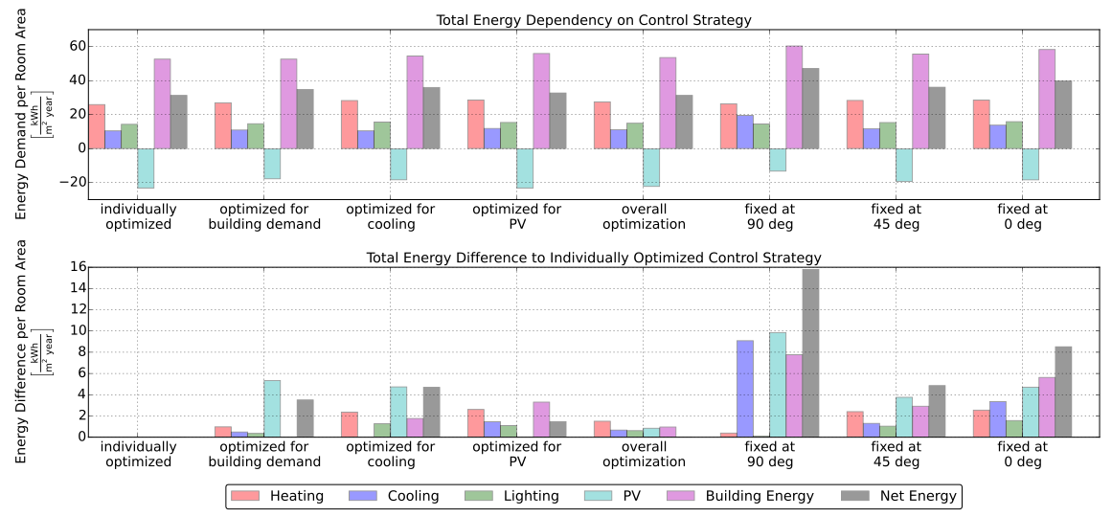
Energy Dependency on Control Strategy
Results for 7 Azimuth and 7 Altitude Angles

Slide 36
Cluster Analysis
2 Clusters
10 Panels for Radiation
5 Azimuth / 5 Altitude Angles
3 Clusters
8 Panels for Radiation
1 Azimuth / 5 Altitude Angles
June
1%
2.3%
Average of
Mar, Jun,
Sep, Dec

Slide 37
Icons Downloaded from:
www.freepic.com
www.flaticon.com

Slide 38
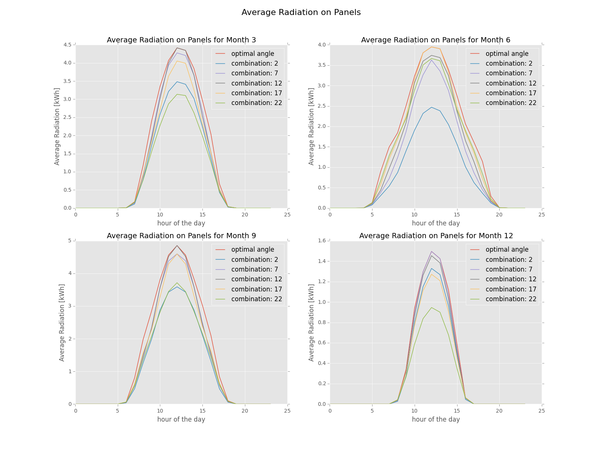
Conclusions
Developed Simulation Framework for the ASF
Optimum Angle Combinations Found
Possibility to Include PV-Electricity Production

Slide 39
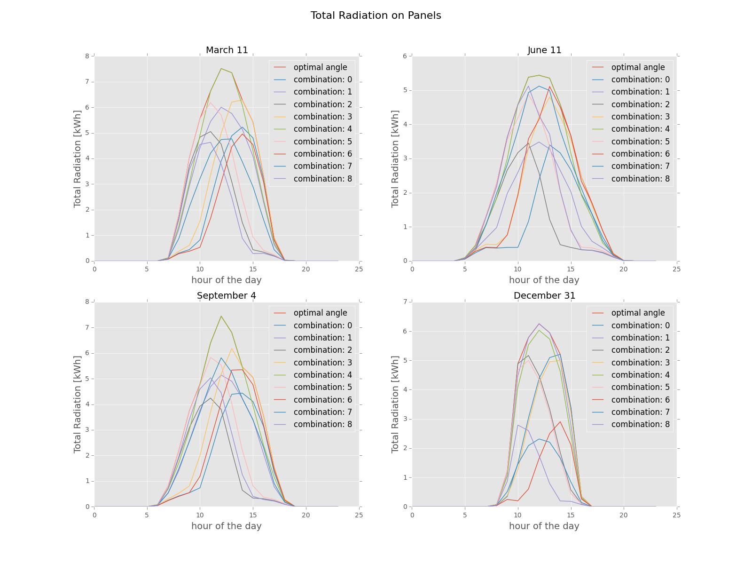
Conclusions
Developed Simulation Framework for the ASF
Optimum Angle Combinations Found
Possibility to Include PV-Electricity Production

Slide 40
Conclusions
Developed Parametric Simulation Model for PV Modules as Adaptive Building Shading Systems
Successfully combined detailed PV-Electricity Production with Building Energy Demand
Optimal Angles for single Cluster found
Sensitivity on Building Orientation, Location, System and Control Strategy evaluated

Slide 41
Outlook
Development and Implementation of RC-Building Energy Simulation Tool
Include Bypass Diodes and String Connection in PV Electricity Simulation
Include Energy-Use for Actuation in Simulation
Implement Iterative Algorithm to increase Accuracy
Extended Evaluation of individual Actuation
Development of Control System for Prototypes of ASF
Life Cycle Analysis

Slide 42
Building Location Performance
Office in Madrid performs best
Highest benefit from ASF for warm
regions

Slide 43
Building System Sensitivity
High sensitivity on heating COP and cooling COP
Lower sensitivity on lighting load and infiltration rate
Notes:
Give Conclusion

